Slide 1
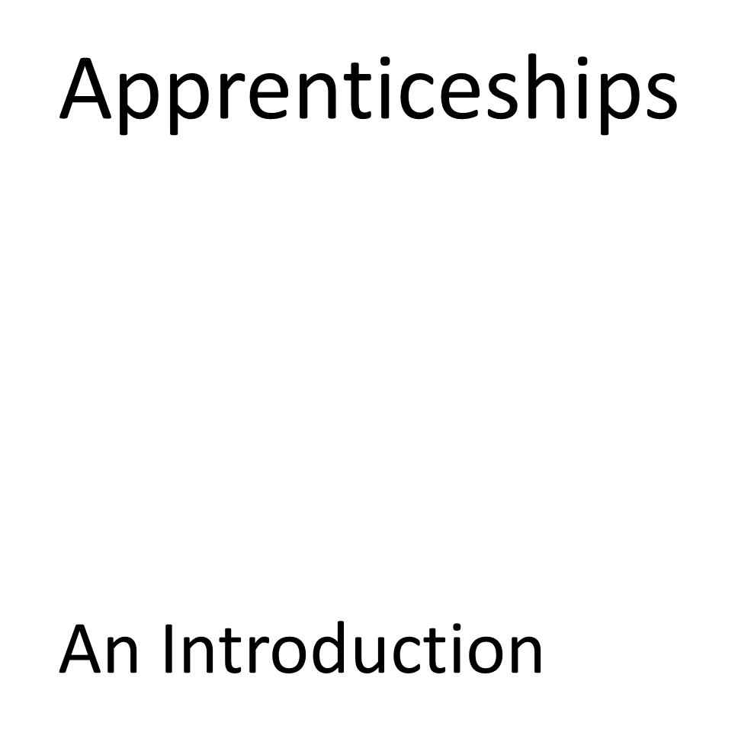




Slide 2


Apprenticeships are essentially a job combined with study. You apply for them like you would do any other job and are not guaranteed to get one just because you apply. You will need to complete an application or submit your CV and will have to attend an interview
As an apprentice you’ll:
• work alongside experienced staff
• gain job-specific skills
• earn a wage and get holiday pay
• get time for study related to your role (usually one day a week)
Apprenticeships take 1 to 5 years to complete depending on their level. Apprenticeships have equivalent educational levels.
Name Level Equivalent educational level
Intermediate 2 GCSE
Advanced 3 A level
Higher 4,5,6 and 7 Foundation degree and above
Degree 6 and 7 Bachelor’s or master’s degree
Some apprenticeships may also give you an additional qualification, such as a diploma.
Notes:
Attendance

Slide 3
You’ll be paid during your apprenticeship and you will be entitled to the National Minimum Wage. Plus you’ll get at least 20 days paid holiday per year, plus bank holidays.
The current minimum wage rate for an apprentice is £6.40 per hour.
This rate applies to apprentices under 19 and those aged 19 or over who are in their first year.
You must be paid at least the minimum wage rate for your age if you’re an apprentice aged 19 or over and have completed your first year.
You must be paid for:
• your normal working hours
• training that’s part of your apprenticeship (usually one day per week)
If you would like more information on Apprenticeships, you can see Mrs Taylor or email s.taylor@bradfordacademy.co.uk
Notes:
Attendance

Slide 4
You can apply for an apprenticeship while you’re still at school. To start one, you’ll need to be:
• 16 or over by the end of the summer holidays
• living in England
• not in full-time education
There are 3 steps to applying for an apprenticeship.
1.Search for an apprenticeship. Click here
2.Sign in or create an account.
3.Complete and submit your application.
The National Careers Service has advice on writing applications and what to do at interviews. Click here
If you’re unsuccessful you can ask for feedback if you don’t get selected for an interview or for the apprenticeship. You can complain if you think you weren’t successful because you were discriminated against, or your treatment in the interview or application process was unfair.
If you feel you’re not ready for an apprenticeship, a traineeship is a course designed to prepare you for one.
Notes:
Attendance

