Slide 1

Multiplication tables check
Parents and carers information meeting
18.3.22

Slide 2
What is the purpose of the check?
The purpose of the MTC is to determine whether year 4 pupils can fluently recall their multiplication tables and are meeting the expected standard for their year group before moving to Year 5.
By the end of Year 4 the expectation is that children will have memorised their multiplication tables up to 12x12 and show precision and fluency in their work.
The check helps teachers identify who needs further support to successfully access the year 5 and 6 maths curriculum.

Slide 3
When will the check happen?
It will happen within a 3 week period in June, from the week beginning 6th June.
You will be informed closer to the time the day school has chosen to administer the check.

Slide 4
How will the check be administered?
Children will be tested using an on-screen check (on a computer or tablet) where children will answer multiplication questions against the clock.
It will be automatically scored and results will be available to schools at the end of the 3 week assessment period.
Results will be shared with parents via a letter.
There is no pass mark for the check.

Slide 5
How will the check be administered?
Children have 6 seconds to answer each question in a series of 25 questions.
There will be 3 practice questions for children to begin with.
There will be a pause of 3 seconds between questions.
Each question will be worth one mark and be presented to the child in
this format:
_ x _ = ____
The test will last no longer than 5 minutes.

Slide 6
The questions
Each pupil will be assigned a randomly set of questions.
Children will only face multiplication statements in the check (not related division facts).
Pupils will not see their individual results when they complete the check.
There will always be questions from the 3, 4, 5, 6, 7, 8, 9, 11 and 12 multiplication tables in each check.
There will be no questions from the 1 times table (i.e 1 x 8 or 8 x 1).
The 6, 7, 8, 9 and 12 times tables are more likely to be asked.
There will only be a maximum of 7 questions from the 2, 5 and 10 times tables.
Reversal of questions will not feature in the same check.

Slide 7
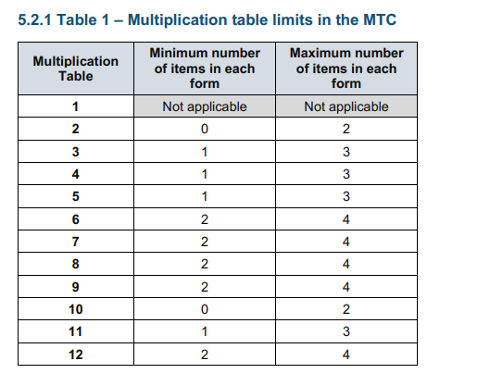
They are classifying the multiplication tables by the first number in the question. For example, 8 x 3 would fall within the 8 times table.

Slide 8
Questions most likely to appear.
The following 11 multiplication questions are more likely to be asked:
• 6 x 6, 6 x 7, 6 x 8, 6 x 9, 6 x 12
• 7 x 8, 7 x 9, 7 x 12
• 8 x 9, 8 x 12
• 12 x 12

Slide 9
How can I support my child?
Short practices daily.
Displaying times tables in your home.
Playing times table games.
Encouraging and rewarding the use of times table rockstars at home.
Using websites that have practice multiplication checks on them-:
https://www.timestables.co.uk/multiplication-tables-check/
https://mathsframe.co.uk/en/resources/resource/477/Multiplication-Tables-Check

Slide 10
Key things to remember
The check will focus on what they know about times tables it won’t reflect their understanding of wider mathematical topics.
Times tables are key to mathematical understanding in Year 5 and 6 so knowing them fluently is incredibly important.
The check is only 5 minutes long. For most children, the check will last for a maximum of 5 minutes. When they have finished, they will not need to repeat the check, regardless of their final score.

Slide 11
Any questions?
If you have any questions after the meeting feel free to speak to me, Mrs Bedford or your child’s class teacher.
Thank you for coming.

