Slide 1
Read Write Inc. Phonics
Parents’ Meeting –
Phonics Screening Check
Notes:
Approximately 10 minutes is needed for this session.
Notes are provided to help you lead the presentation.
Notes in italics are for your attention only.

Slide 2
Reading changes everything
Teach a child to read and keep that child reading and we will change everything.
And I mean everything.
Jeanette Winterson
Notes:
Read quote.
Today I want to help you understand more about the Phonics Screening Check – a word reading test that all Year 1s undertake in June.
Accurate word-reading at six is a good predictor of future reading success.
In December 2018, research found that nearly 90% of children who passed the phonics check taken in Year 1 reached or exceeded the expected standard in reading in Year 6.

Slide 3
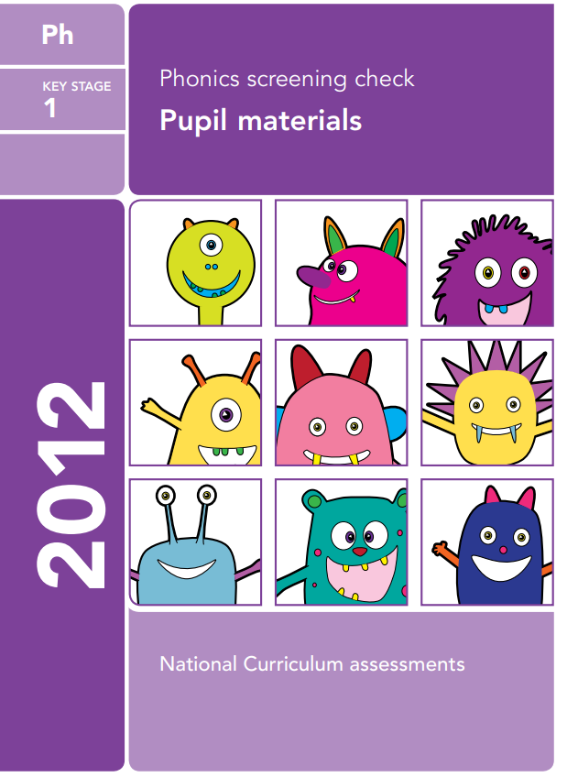
What is the Phonics Screening Check?
A word-reading test at the end of Year 1
Children read 40 words
Notes:
Children complete a word-reading check at the end of Year 1 so that parents can be confident their children are being taught to read successfully.
Children read 40 words. It takes between two and five minutes.
If they do not manage to read 32 of the words, they are given extra support, and repeat the check at the end of Year 2.
It means that all children will be able to read accurately before they begin Year 3.
In our school, we aim to make sure that every child learns to read accurately by the end of Year 1 so they are set up for success in school and in life.
As soon as we spot a child who needs extra practice learning to read sounds and words, we teach them one-to-one for a few minutes every day.

Slide 4
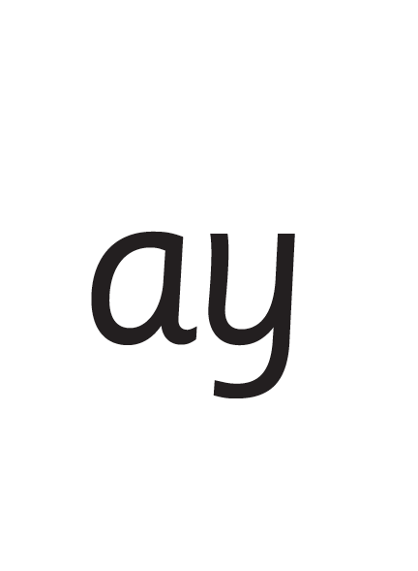
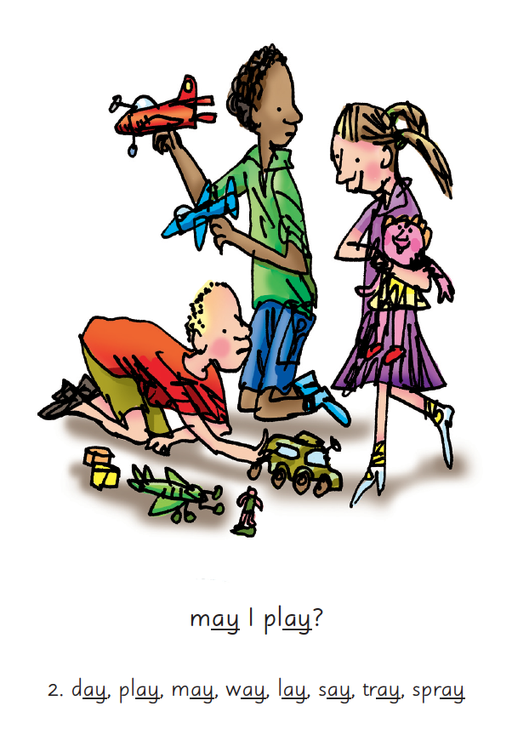

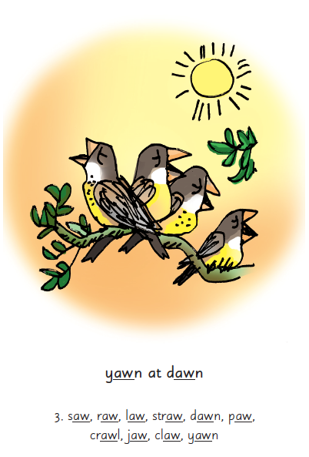
Picture Phrases
Notes:
We teach children sounds using a picture phrases to help them remember.
For example, ay, may I play? aw, yawn at dawn.
Many sounds have two or more letters making one sound. We call these ‘Special Friends’.

Slide 5

‘Special Friends’, ‘Fred Talk’, read the word
Notes:
We teach children to read both real and nonsense words using the routine ‘Special Friends’, ‘Fred Talk’, read the word’.
Children spot the ‘Special Friends’ (two letters that make one sound), Fred talk the word, and then read the word as a whole.
For example, ‘sh’, sh-i-p, ship.

Slide 6



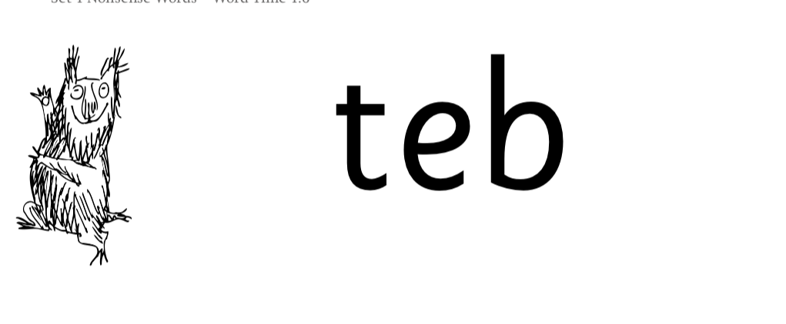
Nonsense words
Notes:
Half of the words in the check are real words.
Half are nonsense words. For example, ‘sheb’, ‘glight’, ‘ched’, ‘teb’.
There is a picture of an alien next to each word to remind the children that it isn’t a real word.
Nonsense words check that children will be able to read sounds they know in unfamiliar words.
Children who can read nonsense words will, very soon, be able to read any new word – for example – gargantuan, flailing, raucous, anticipation;
Reading new words increases children’s vocabulary rapidly.

Slide 7
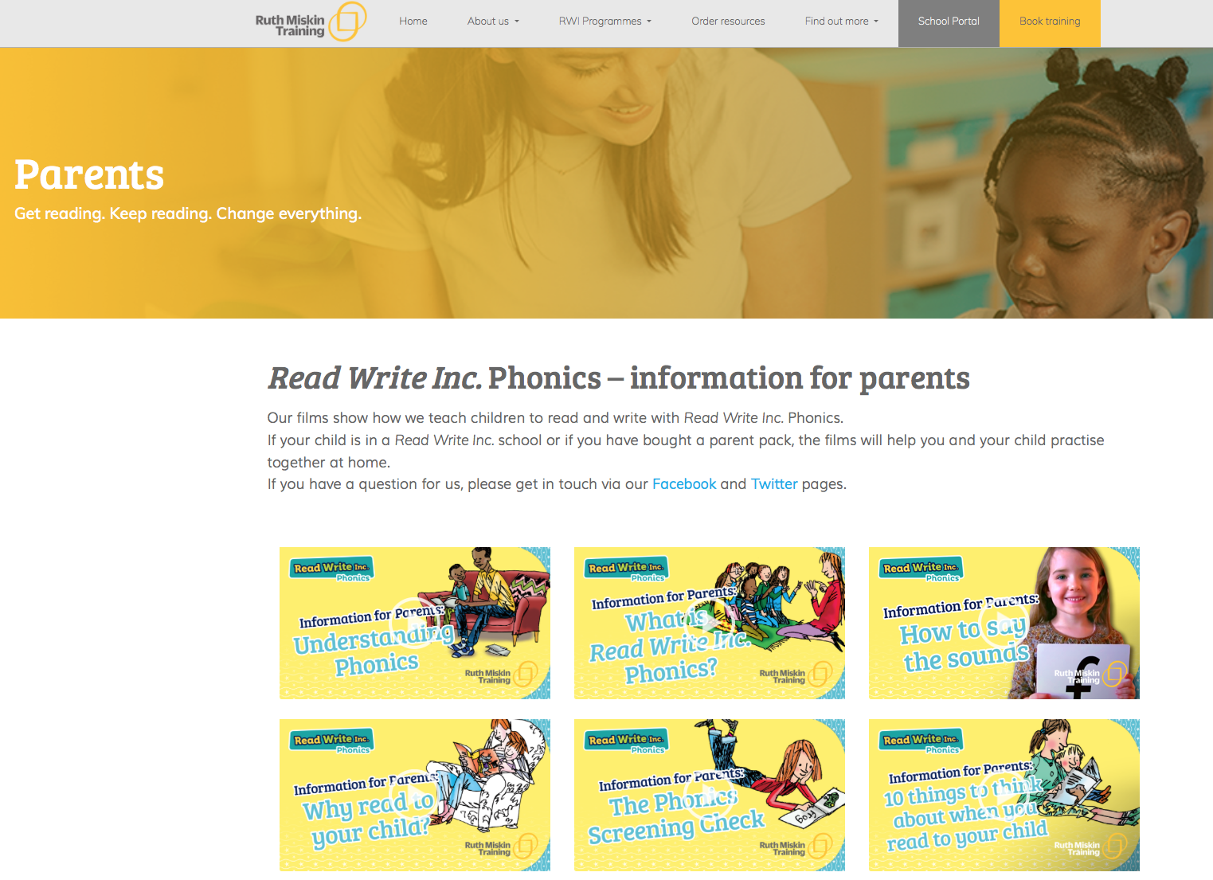
Free Video Tutorials (ruthmiskin.com)
Notes:
Watch these video tutorials on the Ruth Miskin website to find out more about the PSC:
Understanding Phonics
The Phonics Screening Check

Slide 8
What can you do?
1. Use ‘Special Friends’, ‘Fred Talk’,
read the word’ to read words.
2. Practise reading sounds speedily -
‘review, review, review’.
Listen to your child read their Storybook
every day.
4. Use the practice papers with your child.
Notes:
Show how to use Set 2/3 cards if you send these home.
You can purchase Set 2/3 flashcards or My Reading and Writing Kit ages 5-7 becoming a reader to support your child with Set 2 sounds at home.
I will give you a copy of ‘Reading at Home Booklet 2’ from Oxford Owl.

Slide 9
Online resources available
Ruth Miskin Parents’ Page:
http://www.ruthmiskin.com/en/parents/
Ruth Miskin Facebook:
https://www.facebook.com/miskin.education
Free e-books for home reading:
http://www.oxfordowl.co.uk/Reading/

Slide 10
Reading changes everything
Teach a child to read and keep that child reading and we will change everything.
And I mean everything.
Jeanette Winterson
Notes:
Remember that all parents have the power to change outcomes for their children.

Slide 11
Any other questions
Q&A

